Slide 1
INFO 4602/5602
Information Visualization
Individual Project Presentation
Understanding Mental Health Challenges in the Tech Workplace
by Sruthijha Pagolu

Slide 2
Table of Contents
  Project Context & Background
  Motivation & Real-World Relevance
  Key Research Questions
  Data Source & Preparation
  Visualization Design & Individual Charts
  Full Dashboard Presentation
  Findings, Insights, and Recommendations
  Online Dashboard Link

Slide 3
Context & Environment
Why (Purpose) ?
To understand mental health patterns in the tech industry and identify how treatment, workplace comfort, and mental health interference affect employees.
Who (Audience and Impact) ?
Tech employers, HR teams, mental-health advocates, and stakeholders who need insights to improve workplace support and employee wellbeing.
What (Data) ?
Survey data from tech employees (OSMI dataset), including demographics, treatment status, company factors, comfort levels, and work-interference responses.
How (Method) ?
Data cleaning in Python (Jupyter), transformation of variables and visual analysis through Tableau dashboards.

Slide 4
Motivation
  To highlight mental health trends in the tech industry and understand how many employees seek treatment and why.
  To identify workplace factors such as company size and comfort levels that influence mental health-related behaviors.
  To provide actionable insights for employers to improve support systems, reduce stigma, and enhance employee wellbeing.

Slide 5
Key Research Questions
RQ1: How many employees in the tech industry seek mental health treatment, and how does this vary across groups (age, company size)?
RQ2: How often does mental health interfere with employees’ work, and which groups are most affected?
RQ3: How comfortable are employees discussing mental health with coworkers and supervisors?

Slide 6
Data Source & Discussion
Dataset: OSMI Mental Health in Tech Survey (public dataset from Kaggle)
  735 responses from tech industry employees.
  Contains demographics, workplace factors, treatment status, and mental-health perceptions.
Data Cleaning & Preparation:
  Standardized inconsistent entries (e.g., gender, country, state, company size).
  Removed irrelevant or incomplete rows and filtered to U.S. respondents only.
  Grouped ages into meaningful decade ranges (20–29, 30–39, etc.).
  Simplified categories (Yes/No, Small/Medium/Large companies, etc.).
  Handled missing values in work_interfere and comfort fields.
Exported the cleaned dataset for Tableau dashboard creation.

Slide 7
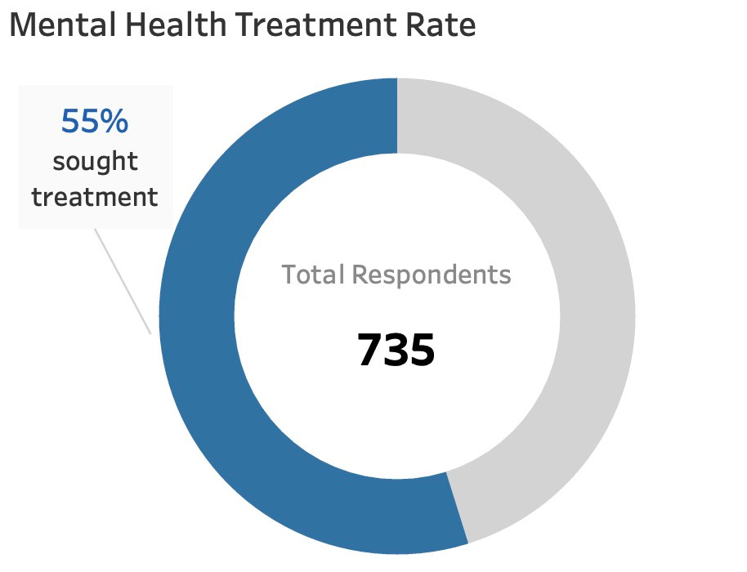
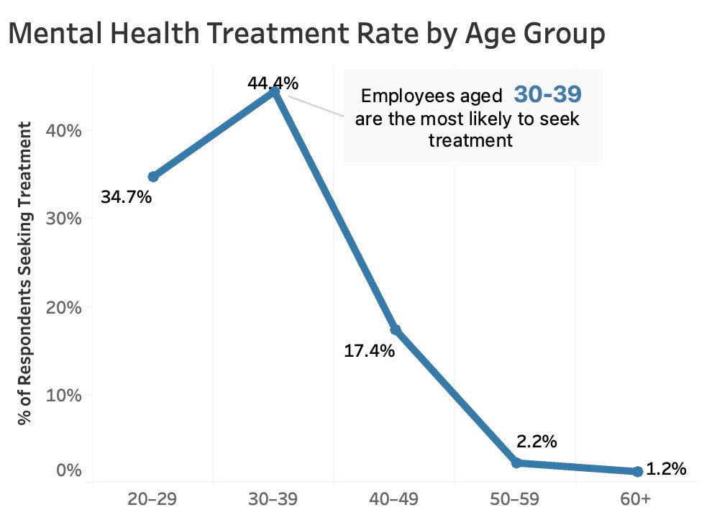
Chart 1:

Slide 8
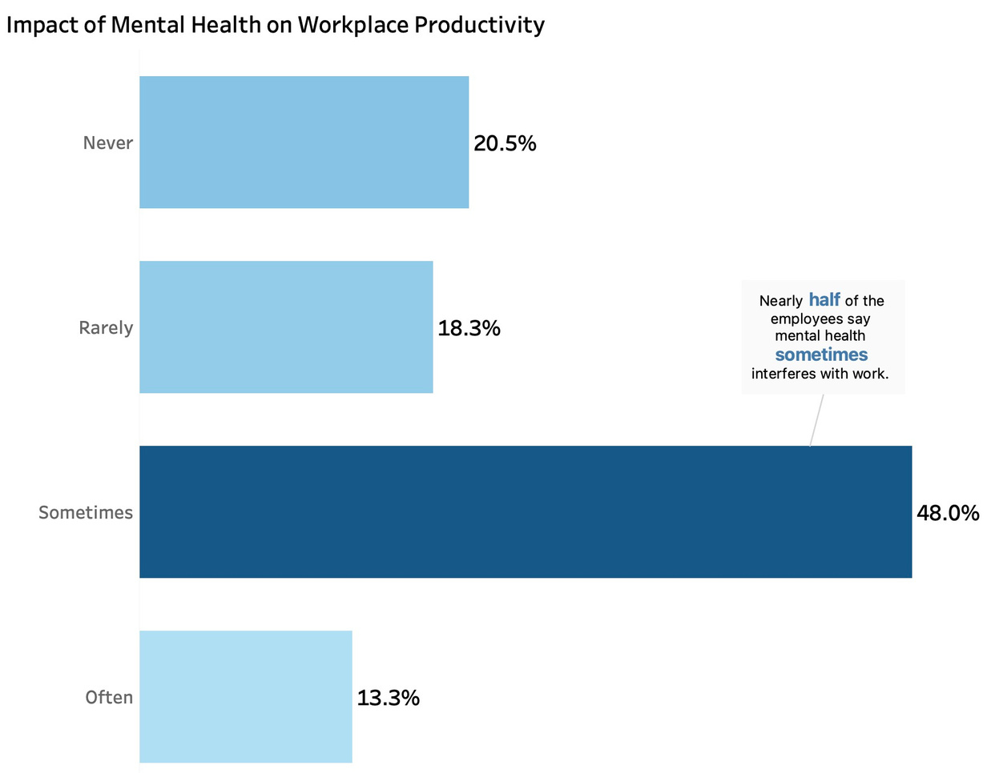
Chart 2:
Notes:
9

Slide 9
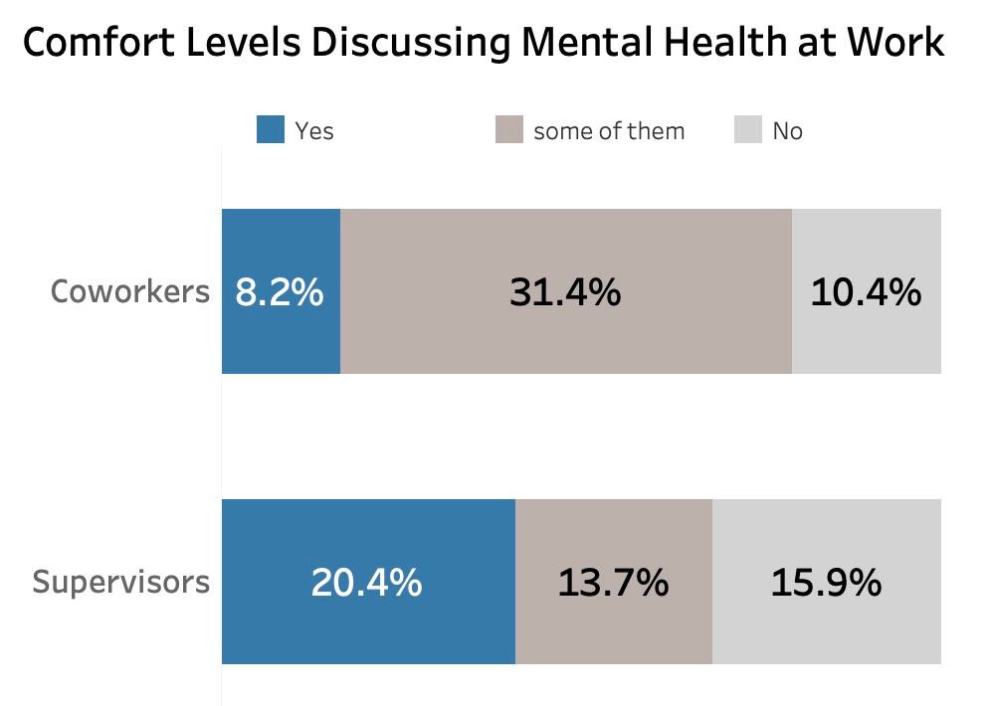
Chart 3:
Notes:
9

Slide 10
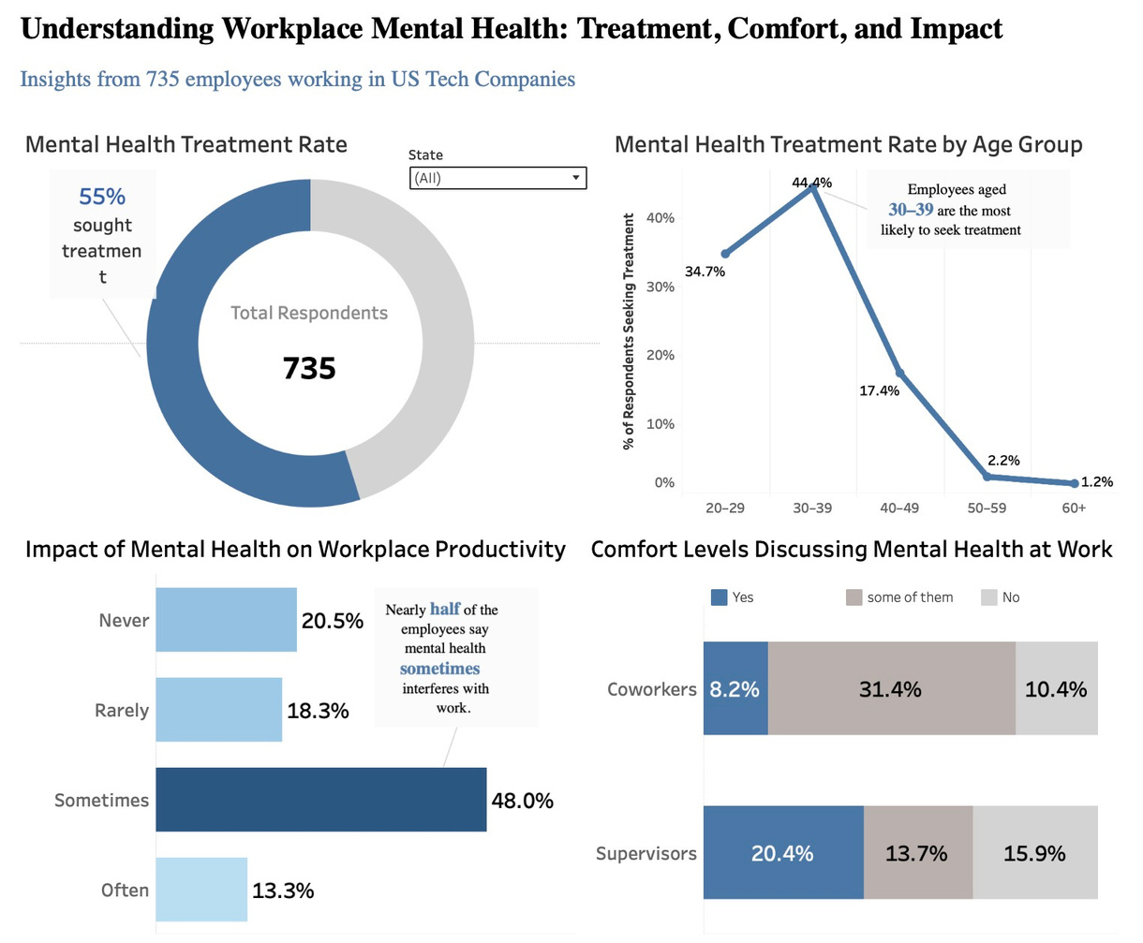
Tableau Dashboard

Slide 11
Answers to Research Questions + Recommendations
RQ1: 55% of tech employees have sought mental-health treatment; highest among ages 30-39.
RQ2: Nearly half (48%) report mental health sometimes interferes with productivity.
RQ3: Employees are more comfortable with coworkers than supervisors when discussing mental health.
Recommendations:
  Enhance Support: Provide accessible counseling/EAP resources and promote them clearly.
  Manager Training: Improve supervisor awareness and communication to reduce stigma.
  Strengthen Culture: Normalize mental-health conversations through workshops and peer support.
  Focus on High-Risk Groups: Prioritize younger employees (20–39) who show higher impact levels.

Slide 12
URL: Tableau Dashboard Link

Slide 13

THANK YOU :)
Questions ?

